Slide 1
Frame Work Application “We can solve any problem by introducing an extra level/layer of indirection [abstraction].” David Wheeler British Computer Scientist
Group 3

Slide 2
Design Patterns
Observer
Command
Template Method
Factory Method
Strategy
Singleton

Slide 3
THE MAIN OO PRINCIPLE
Program to interface
Favor Composition over inheritance
encapsulate what varies(separate changing from non changing)
Open for extention closed for modification
Loose coupling between object that interact
Depend on abstraction not on concrete class

Slide 4
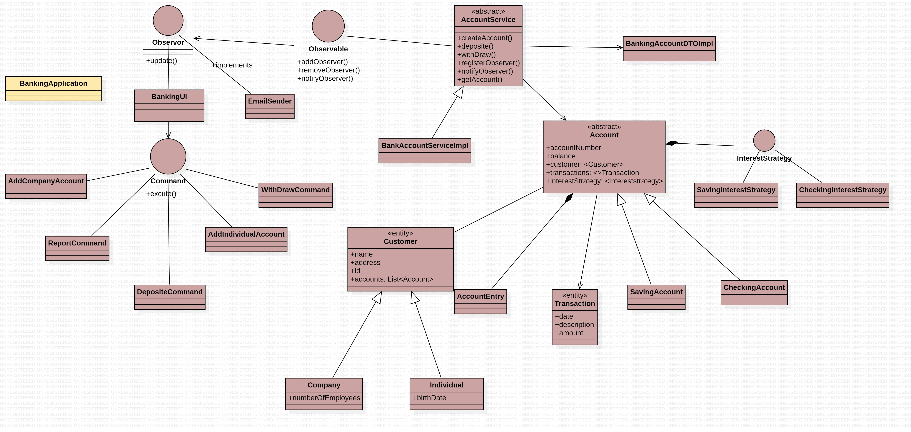
Banking Application

Slide 5
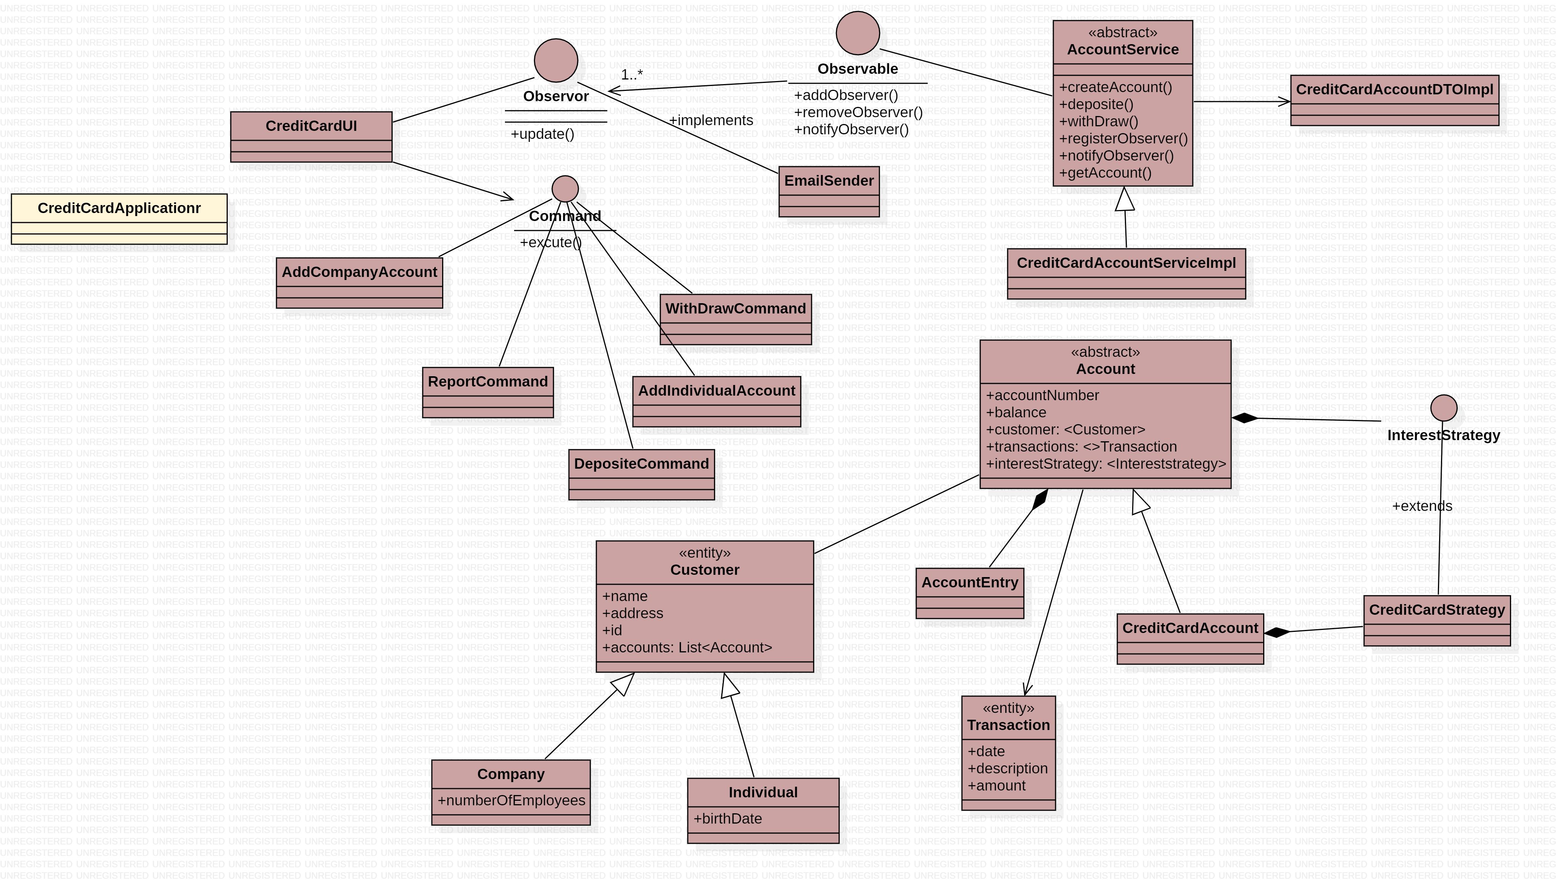
Credit Card Application

Slide 6
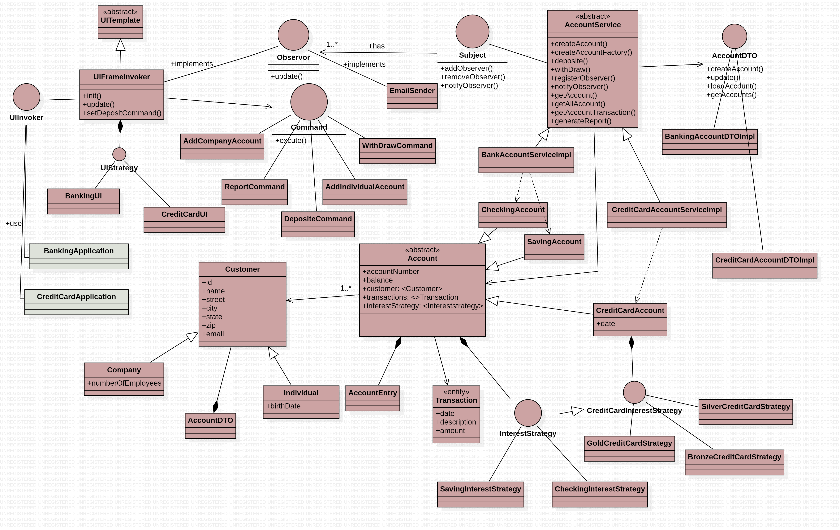
The Class - Diagram

